Slide 1
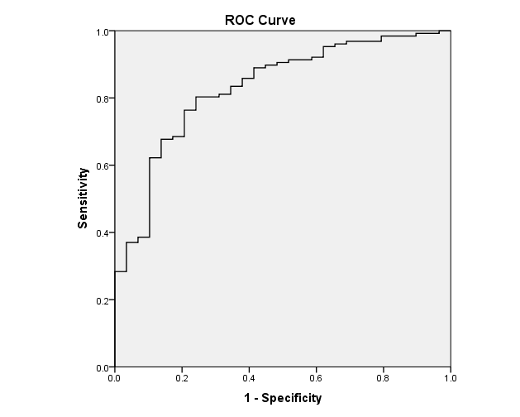
Supplementary Figures
The figure shows the sensitivity and 1-specificity of the IPF total score in identifying significant clinician-rated functional impairment in the work or relationship domains. Area under the curve = .83.

Slide 2
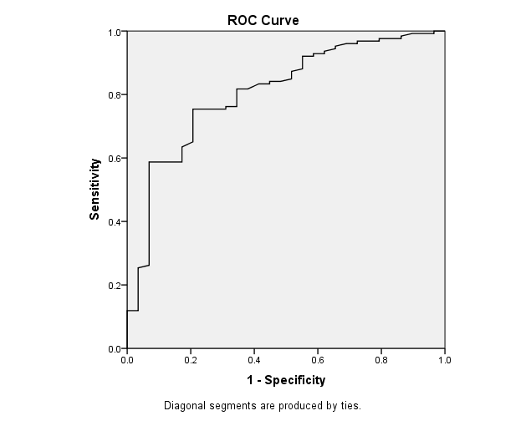
The figure shows the sensitivity and 1-specificity of the WHODAS 2.0 total score in identifying significant clinician-rated functional impairment in the work or relationship domains. Area under the curve = .81.

Slide 3
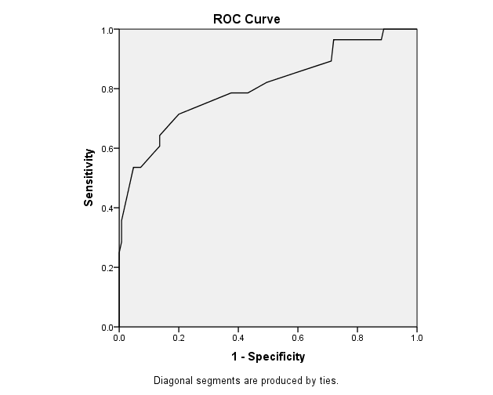
The figure shows the sensitivity and 1-specificity of the GAF in identifying significant clinician-rated functional impairment in the work or relationship domains. Area under the curve = .81.

