Slide 1
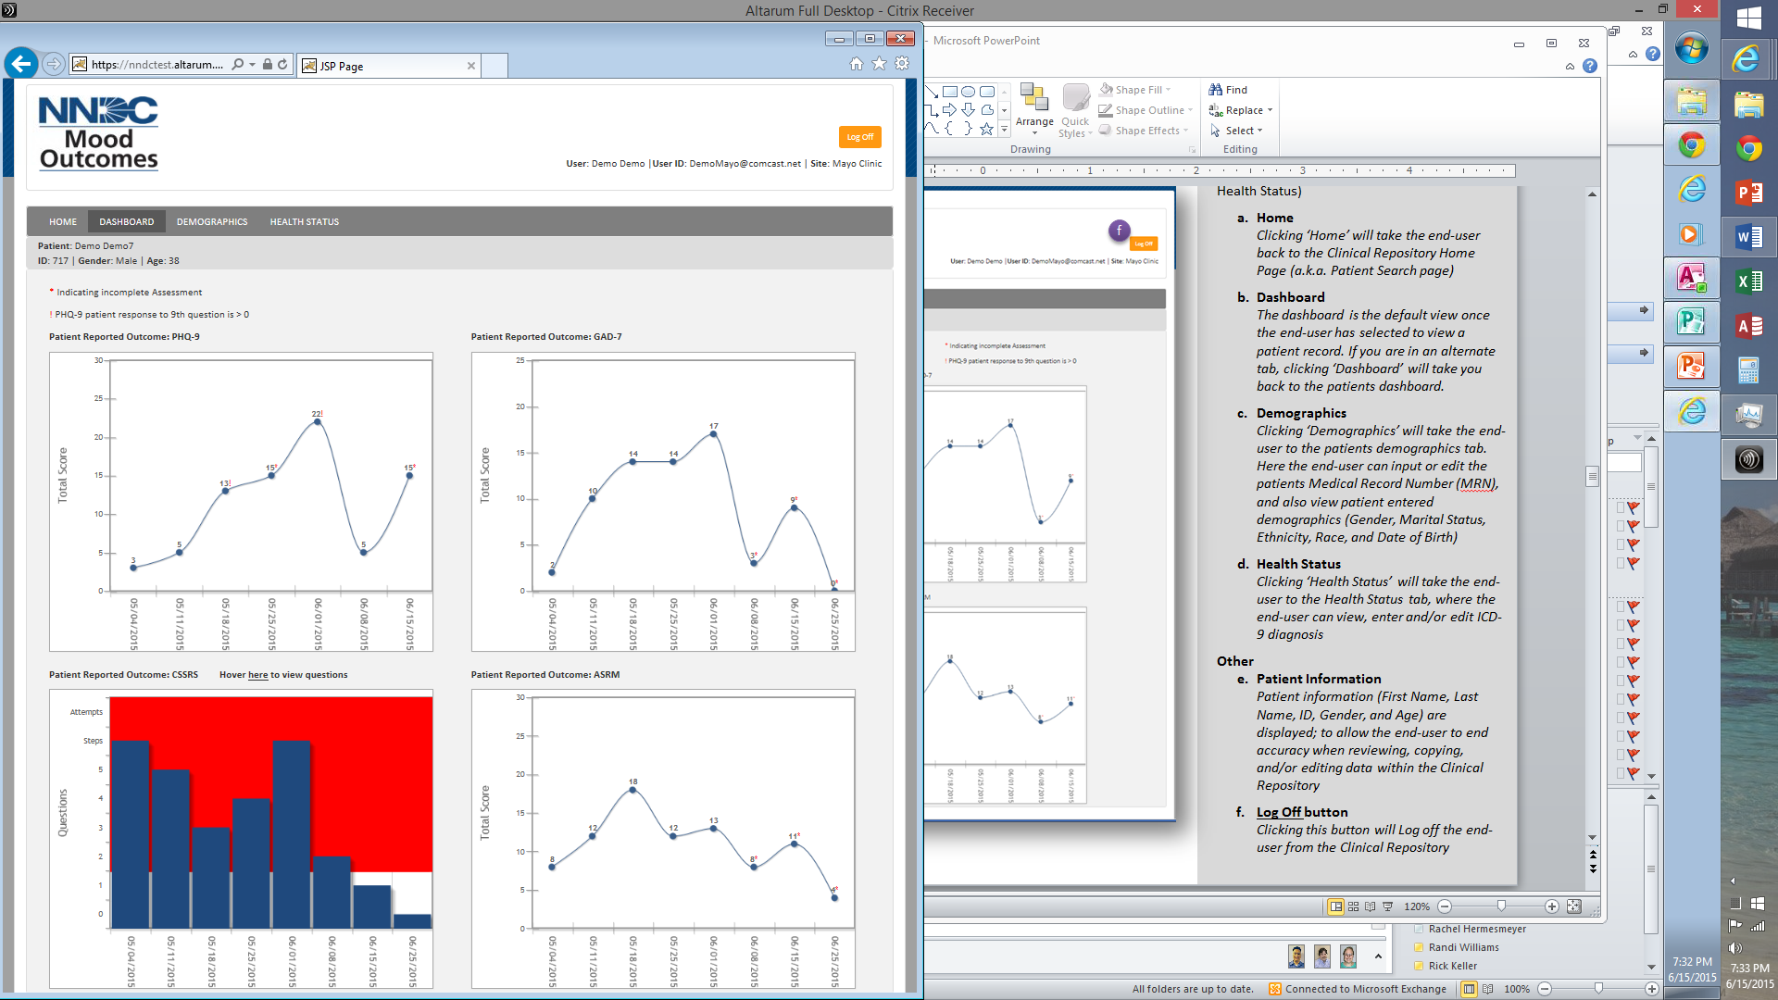
Supplemental Figure 1. Mood Outcomes Program Clinician Dashboard displaying the longitudinal results of a patient on the four patient reported outcome measures: PHQ-9, GAD-7, ASRM, and C-SSRS. The responses are flagged if answers are incomplete and if there is concern about suicide risk that the providers should attend with the patient. The provider may additionally click to answers to specific questions and copy and paste the graphs and responses to questions to the patient’s electronic medical record if desired.

